Slide 1
Lab 03: Recursion
CS 0112
Fall 2021

Slide 2
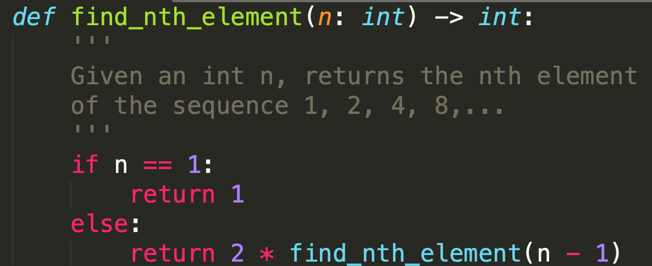
Recursion
Recursive definition refers to itself
Many concepts can be defined recursively
Formulas, Functions, Data Structures
Ex: Recursive Formula
S_{n} = 2(S_{n-1}) to find n^{th} element of the sequence S = 1, 2, 4, 8,...
Ex: Recursive Function

Slide 3

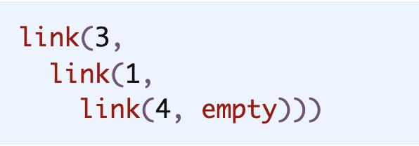
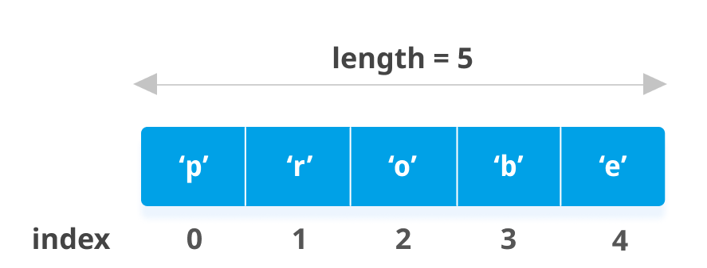
Recursive Data Structures
Pyret List
Pyret Lists: A recursive data structure
Recursive definition allows you to have lists of arbitrary length
Adding elements to a list is cleaner
Just add a pointer to the next element(like the diagram on the right)
Removing elements takes less space for lists in the form of Pyret lists (recursive), rather than Python lists that are more linear in form.
Recursive Lists
Python List

Slide 4
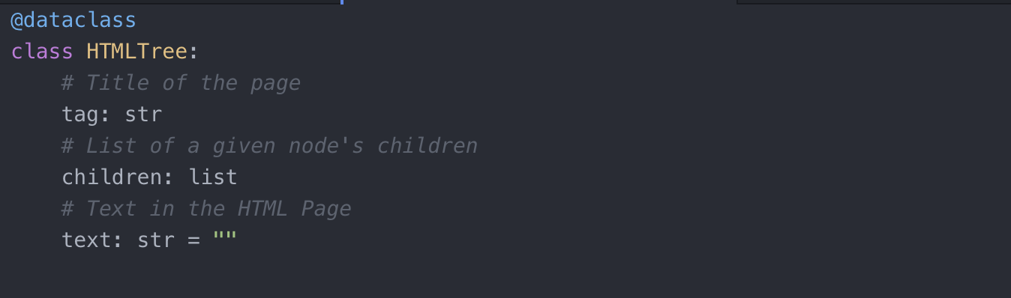
HTML Tree
Recursively defined Data Structure
HTMLTree was discussed in lecture and will be used in the Lab Assignment!

Slide 5
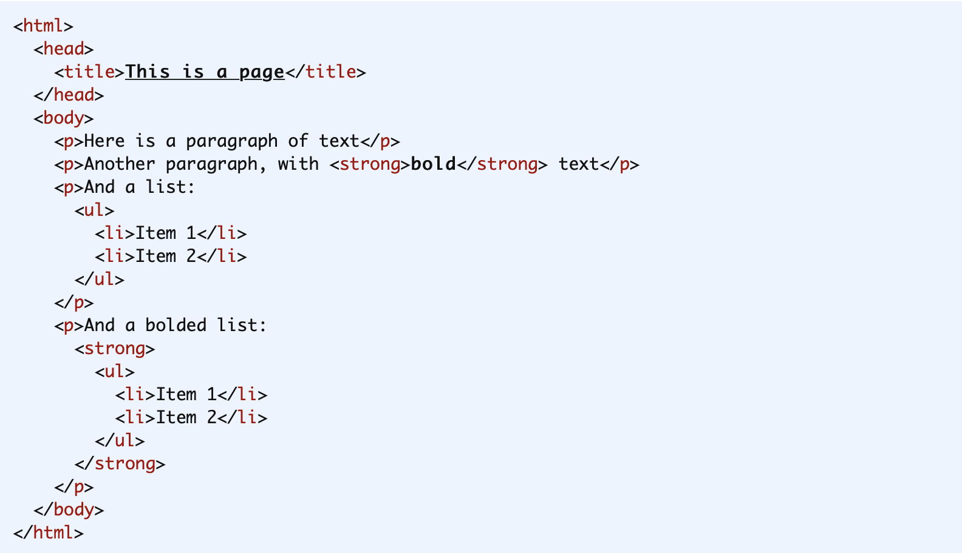
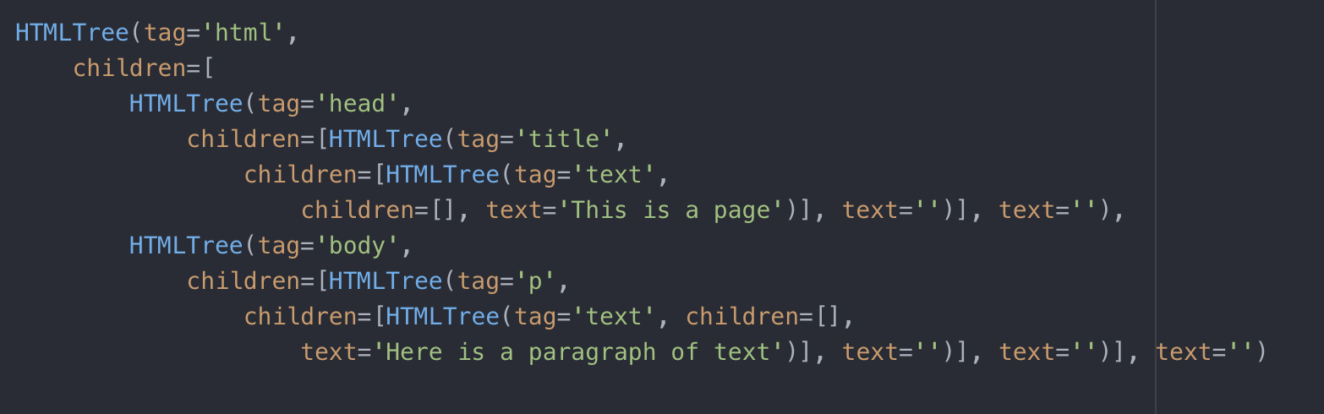
HTML Doc vs. HTML Tree Representation
Tree Representation
html
head
body
title
p
“Here is a paragraph of text”
“This is a page”

Slide 6
Why Define HTML Trees Recursively?
If you wanted to access a list that is nested, need to know how many tags to loop through
Recursive Tree allows you to recursively call while Tree has children
Don’t need exact # of times to loop
Structure (nestedness) of HTML Doc is already similar to that of a Tree
Nested Tags are children of Parent Tag
parent tag
child tag

Slide 7
Example - Recursive Function on HTML Tree
Remember: To parse an HTML tree, we parse through the smaller ‘children’ HTML trees
count_tag(tree: HTMLTree, tag: str): count the number of specific tag input (i.e. “p”) an HTML Doc has
Recurs through every child in HTML Tree and if the tag is equal to the input tag (i.e. “p”), add 1
HTMLTree
div
div
title
p
p
img
“This is a page”
“Text1”
“Text2”
Image

Slide 8
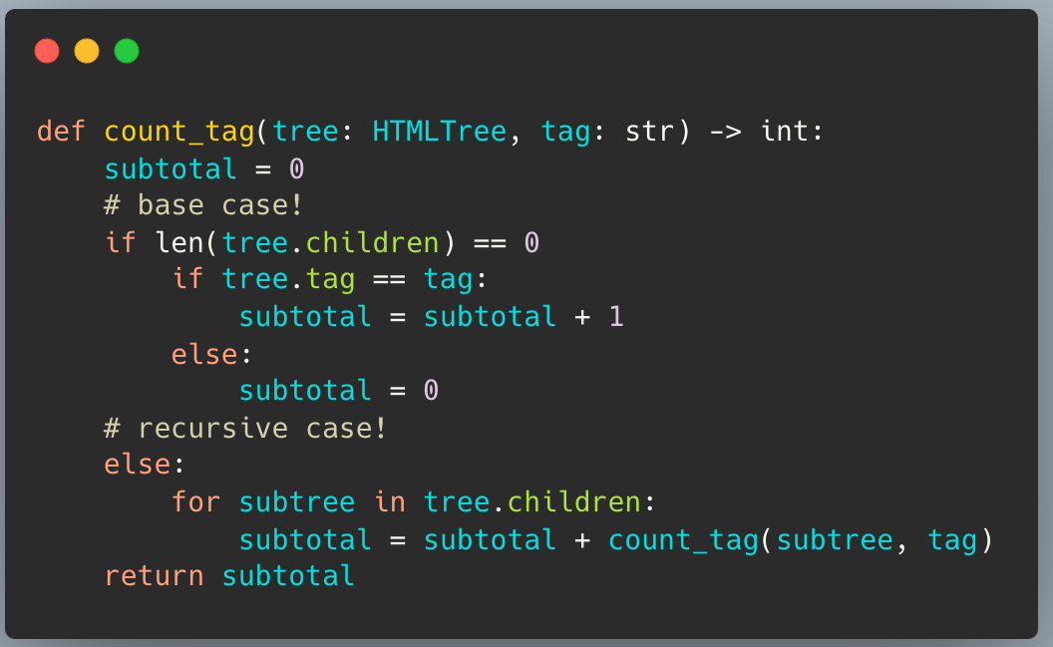

Slide 9
Any Questions?

